Slide 1
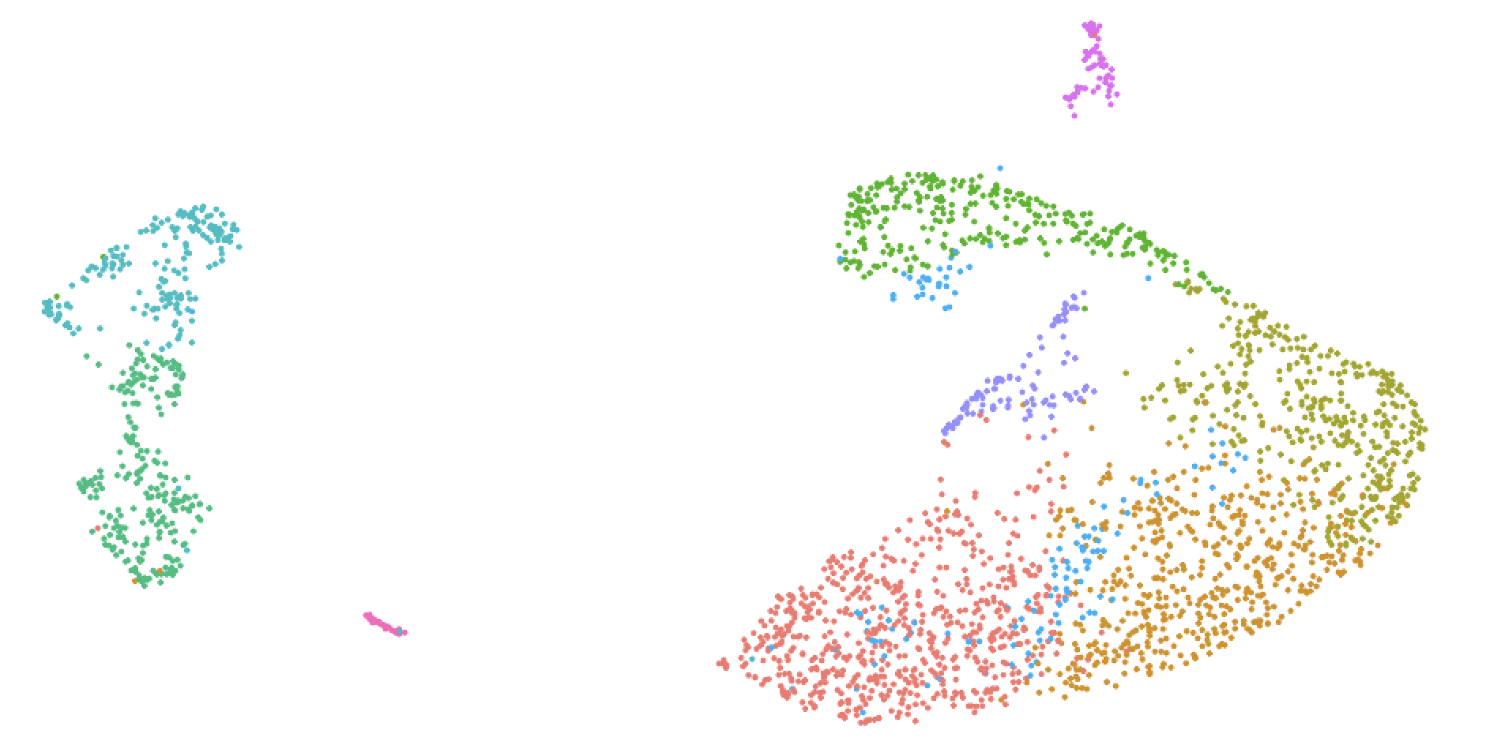
Exploring Microglial Heterogeneity: Transcriptomic Insights into Maternal Stress Responses
Dec. 6th 2024
NRSC 510A final presentation
By Krysia MacRae
Dr. Rosin lab
Notes:
For this presentation I will talk about exploring microglial heterogeneity and the transcriptomics insights into maternal stress responses

Slide 2
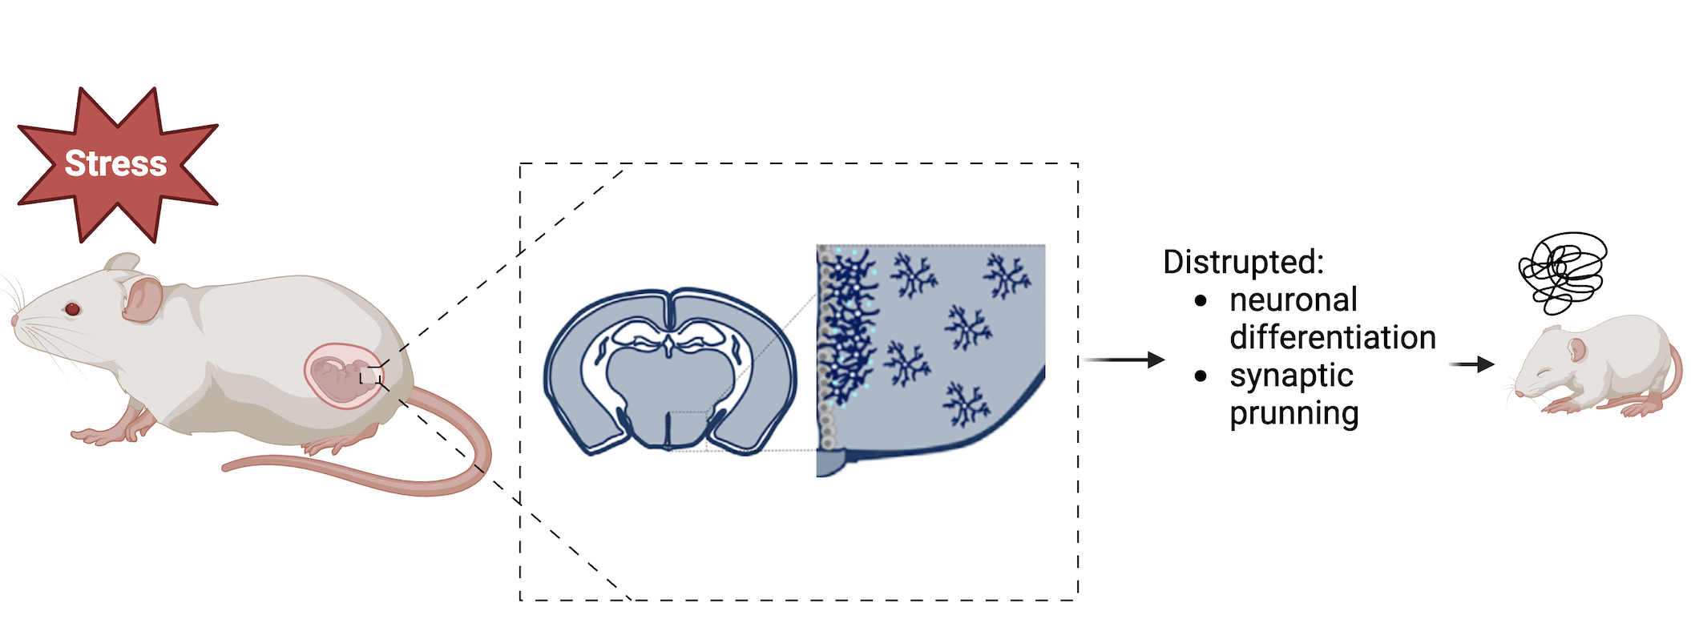
Background information
Introduction
Research landscape: developmental neuroscience
Maternal stress disrupts offspring neurodevelopment, leading to long-term behavioural and cognitive challenges
Knowledge gap: how do hypothalamic microglia interact with neural cells to change their development?
Rosin, 2021
Notes:
My project focuses on the field of developmental neuroscience
Maternal stress disrupts offspring neurodevelopment, leading to long-term behavioural and cognitive challenges.
It activates microglia (the brain’s immune cells) in the hypothalamus, which in turn affect neural progenitor development, impacting processes such as neuronal differentiation and synaptic pruning which may even lead to neurodevelopmental disorders
But, the way in which hypothalamic microglia interact with neural cells to change their development is understudied

Slide 3
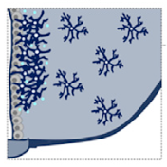
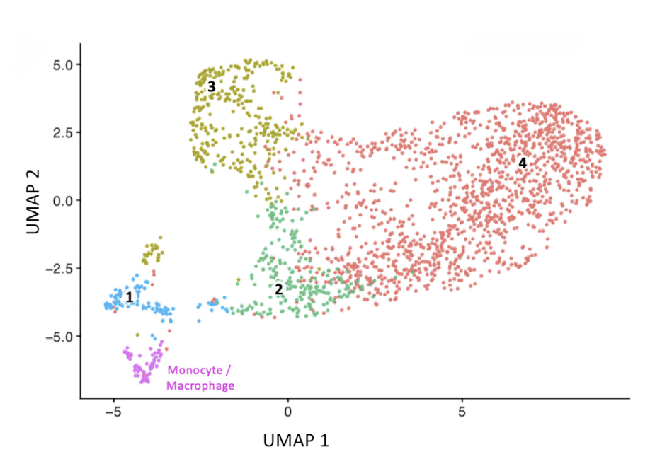
Rosin et al. (2021)
Introduction
Notes:
Rosin et al. found that there are four distinct microglial clusters of hypothalamic microglia, one of which is in direct contact with nearby NSCs and responded to maternal cold stress.
This is a UMAP plot visuazling 4 clusters of similar microglia based on their gene expression proflies. Here, increasing heterogeneity in the data is represented by the increasing distance between the data points.

Slide 4
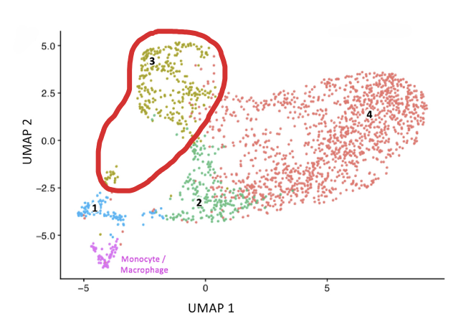
Research question
Introduction
How do transcriptomic differences, within a specific subtype of hypothalamic microglia identified in Rosin et al. (2021) reflect the heterogeneity in microglial responses to maternal stress?
Notes:
However, the heterogeneity within microglial subpopulations remains underexplored.
I am trying to answer the question: how do transcriptomic differences, within a specific subtype of hypothalamic microglia identified in Rosin et al. (2021) reflect the heterogeneity in microglial responses to maternal stress?
Initially, I’ve decided analyze cluster 3, since it is the most heterogenous based on the UMAP plot. This project aims to improve our understanding of how microglial diversity impacts neurodevelopmental programs in response to maternal stress. These findings could help uncover underlying mechanisms involved in NDDs, enabling identification of vulnerable pathways for interventions

Slide 5
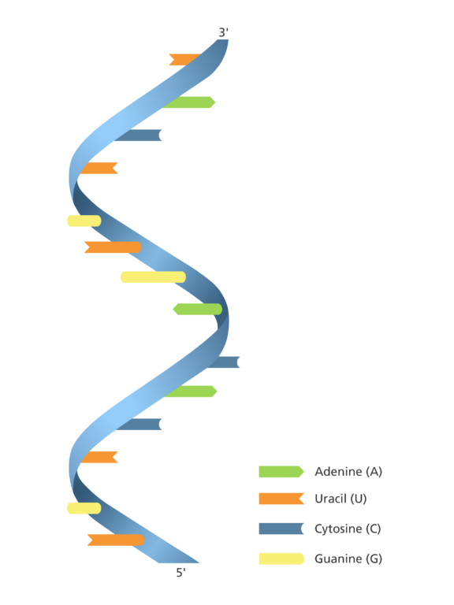



Methods overview
Methods
Programming language:
No previous experience
Type of data: scRNA seq
Assistance:
TA: Margo
Packages:
Notes:
I conducted all of my analyses in R, despite having no prior experience with the platform. As mentioned earlier, I utilized several packages—Seurat, dplyr, devtools, ggplot2, and enrichR—to analyze my scRNAseq data. Throughout this process, I worked with chatgpt and my TA Margo, who has been incredibly helpful.

Slide 6
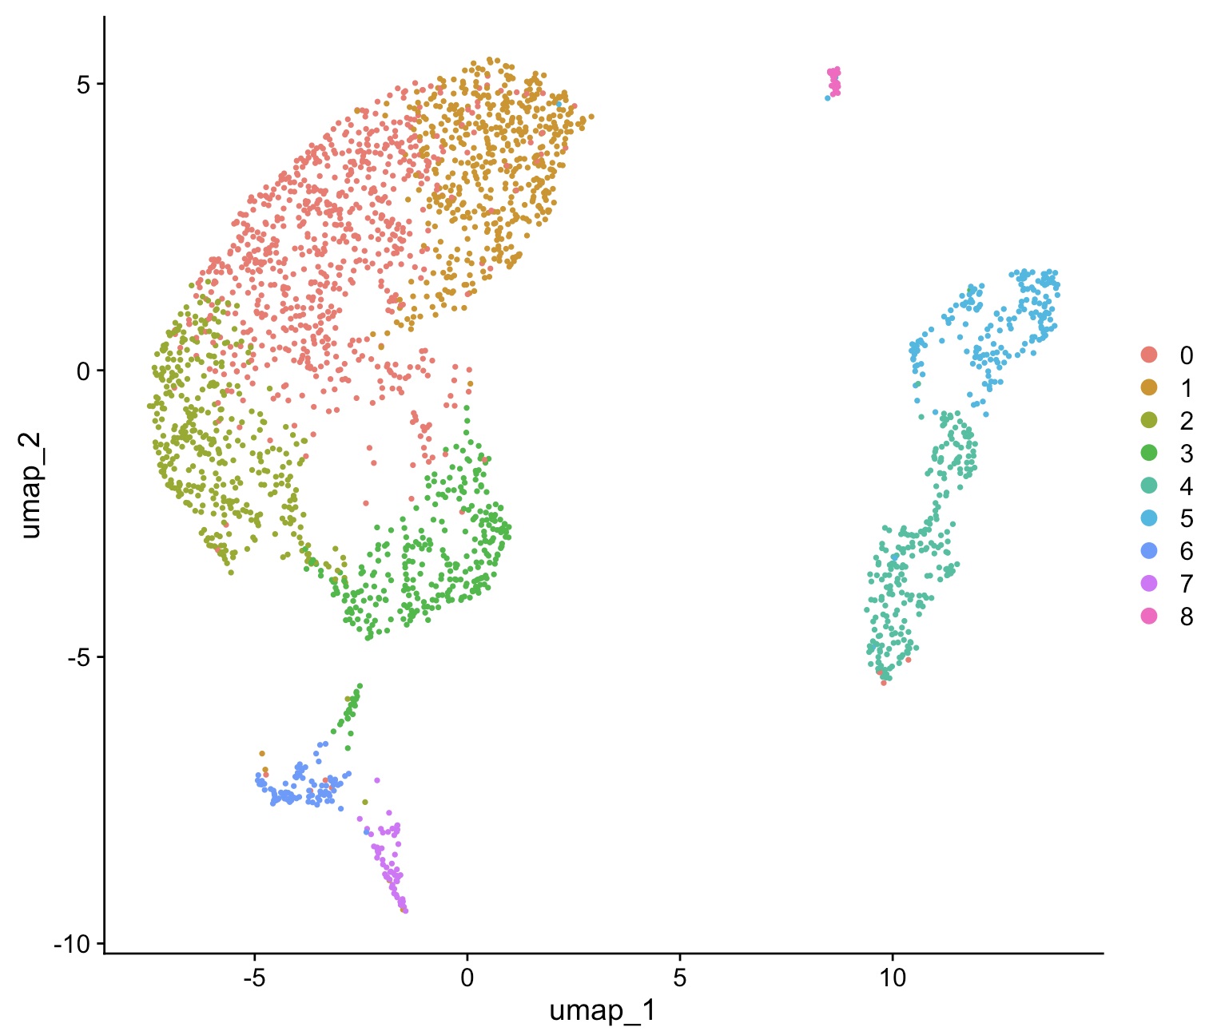
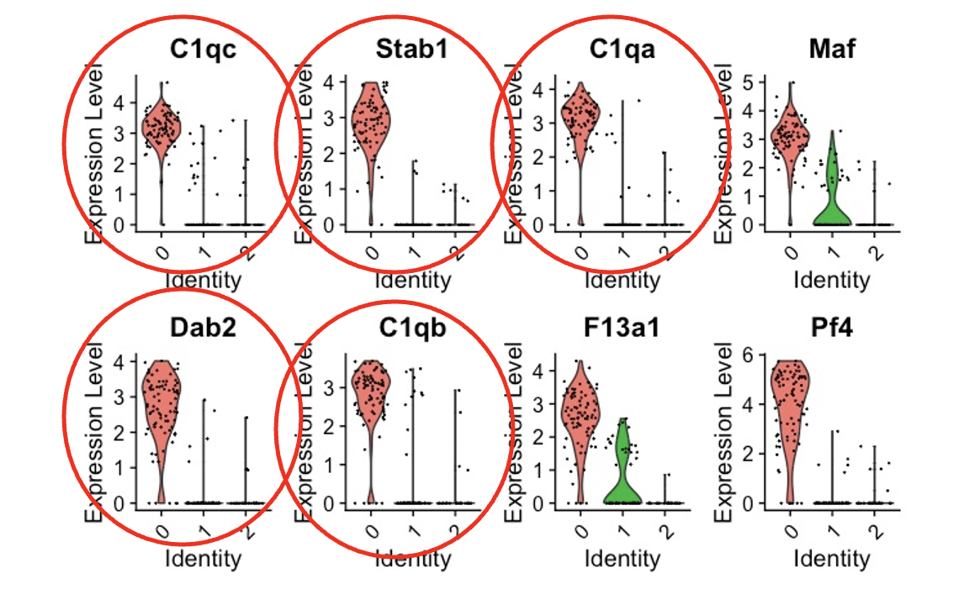



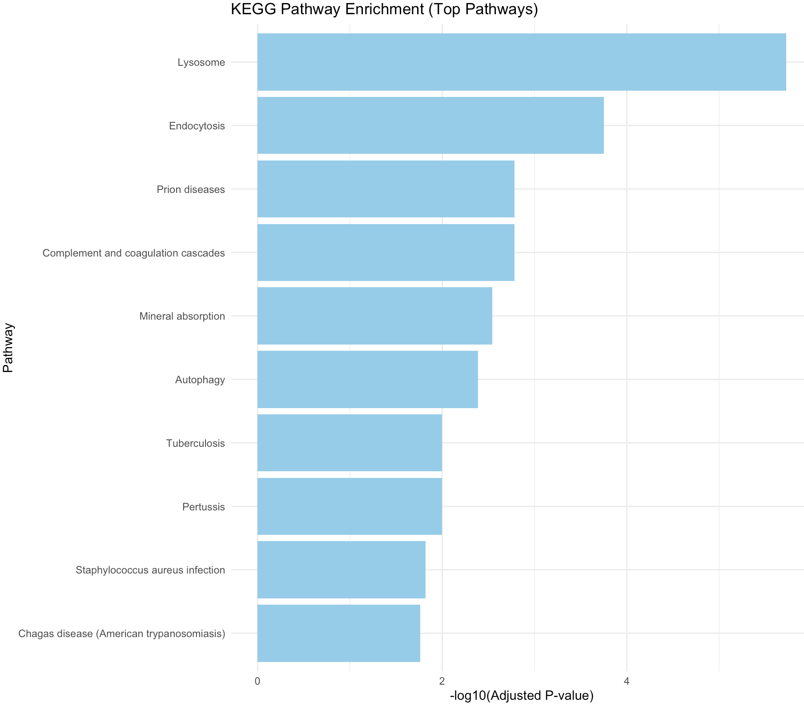


Coding steps (major steps)
Methods
Preparing data
Merging/integrating data
Quality control
Normalizing data
PCA
Clustering
Reclustering
Finding marker genes
Pathway enrichement analysis (GO and KEGG)
Grouping clusters by condition
Notes:
Here are the main coding steps I followed, along with the packages I used throughout my analysis. I’ve included a few images of the analysis outcomes to give you a preview of what’s coming.
Seurat: Analyzes and visualizes single-cell RNA sequencing data, including clustering and UMAP plotting.
dplyr: Simplifies data manipulation in R with functions for filtering, grouping, and summarizing data.
devtools: Streamlines R package development and installation of packages from sources like GitHub.
ggplot2: Creates elegant and customizable data visualizations, such as scatter plots and bar charts.
enrichR: Performs gene set enrichment analysis to identify biological pathways and functions from gene lists.

Slide 7
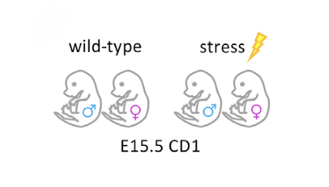
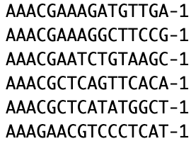
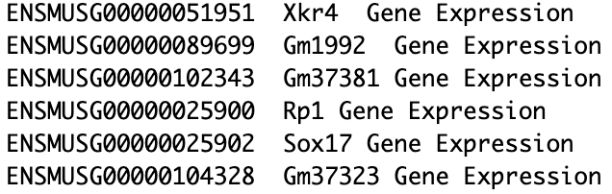
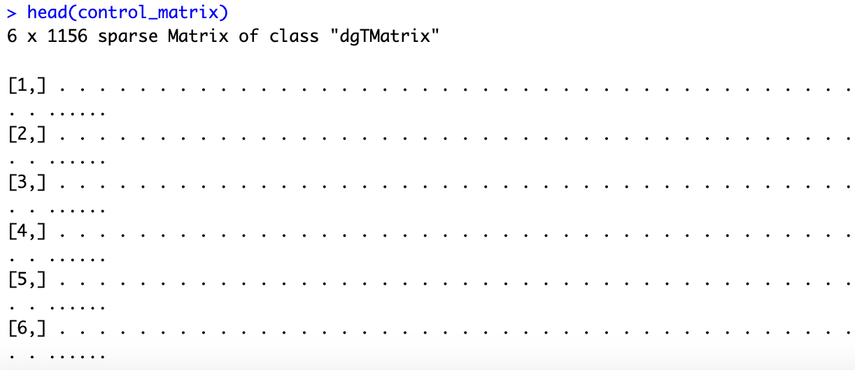
Datasets
Methods
barcodes.tsv :
features.tsv:
matrix.mtx:
Notes:
Rosin et al. used WT and stress CD 1 mice and consequently for each condition there are 3 files:
As I mentioned before, gene IDs, cell IDs, matrix of counts per gene for every cell.
a file with the gene IDs, representing all genes quantified
a file with the cell IDs, representing all cells quantified
a matrix of counts per gene for every cell
In the matrix rows are associated with the gene IDs and columns correspond to the cellular barcodes

Slide 8
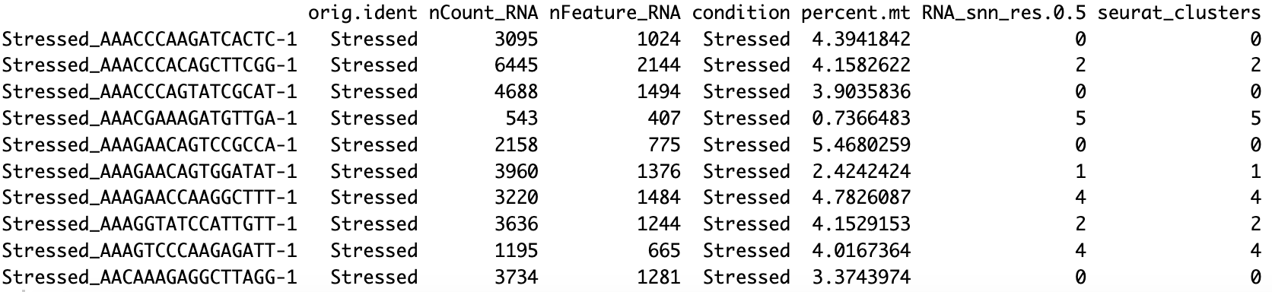
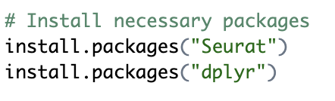
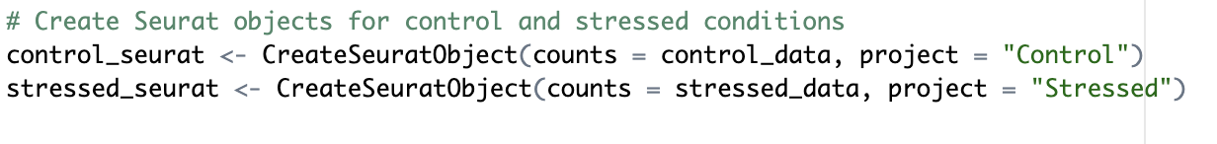
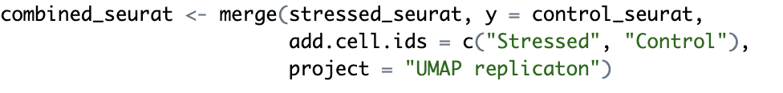
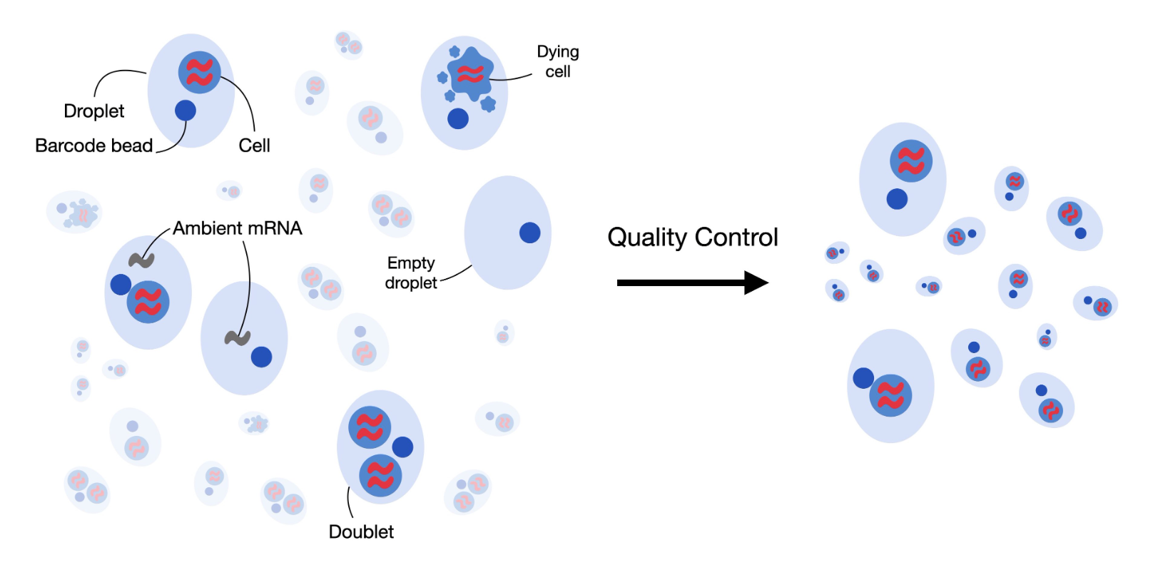
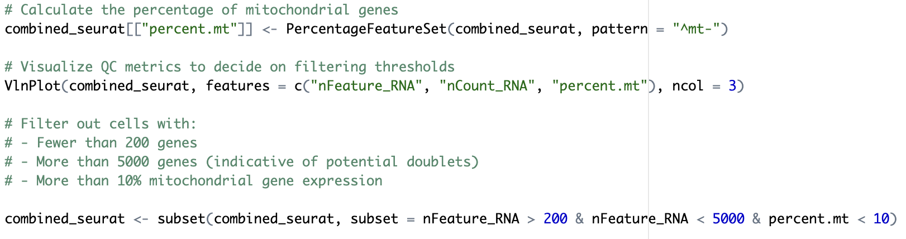
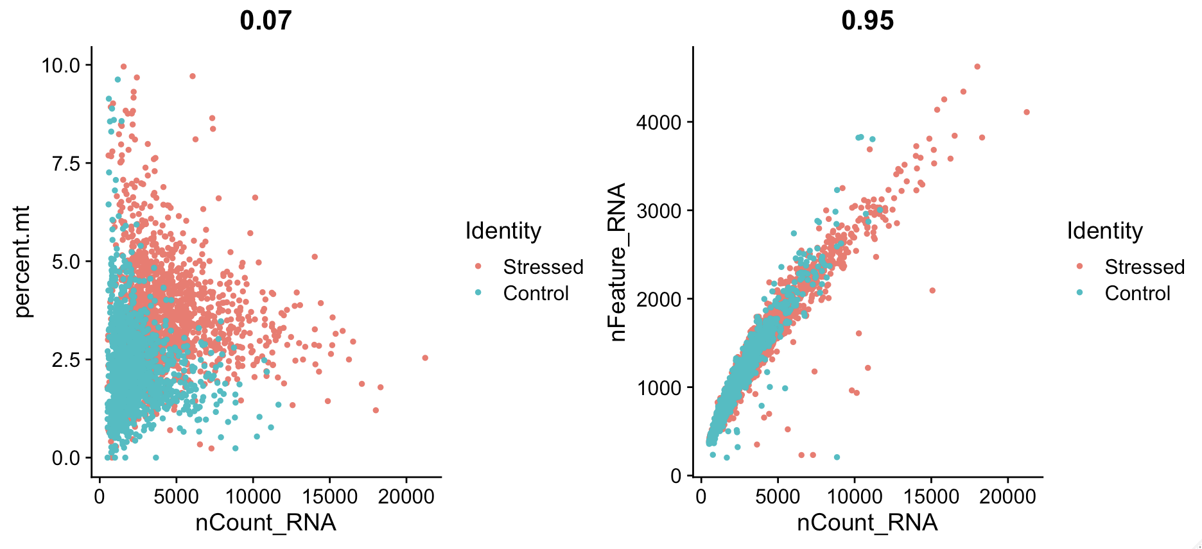
Preparing data
Results
combined_seurat: [31053 x 2623]
Quality control
combined_seurat: [31053 x 2568]
Notes:
As I mentioned before, I first prepared my data, which involved installing packages and loading libraries and creating my combined Seurat object.
Then, in the quality control step I filtered out cells from the data that were of poor quality.
The left Plot, on the y axis shows the percentage of mitochondrial gene expression in each cell and on the x axis indicates the total number of RNA molecules (counts) per cell. In this plot, it appears that the stressed condition (red points) has more cells with higher mitochondrial percentages compared to the control (blue points). This suggests that cells in the stressed condition may have more variation in quality.
The right Plot, on the y axis shows the number of unique genes detected in each cell, the x axis shows the total RNA count per cell. There is a strong correlation (0.95), which is expected, as cells with more RNA molecules often have more detected genes. This plot shows that both stressed and control cells have a similar relationship between total RNA counts and gene diversity, but there may be some slight variation in counts and features between the conditions.

Slide 9
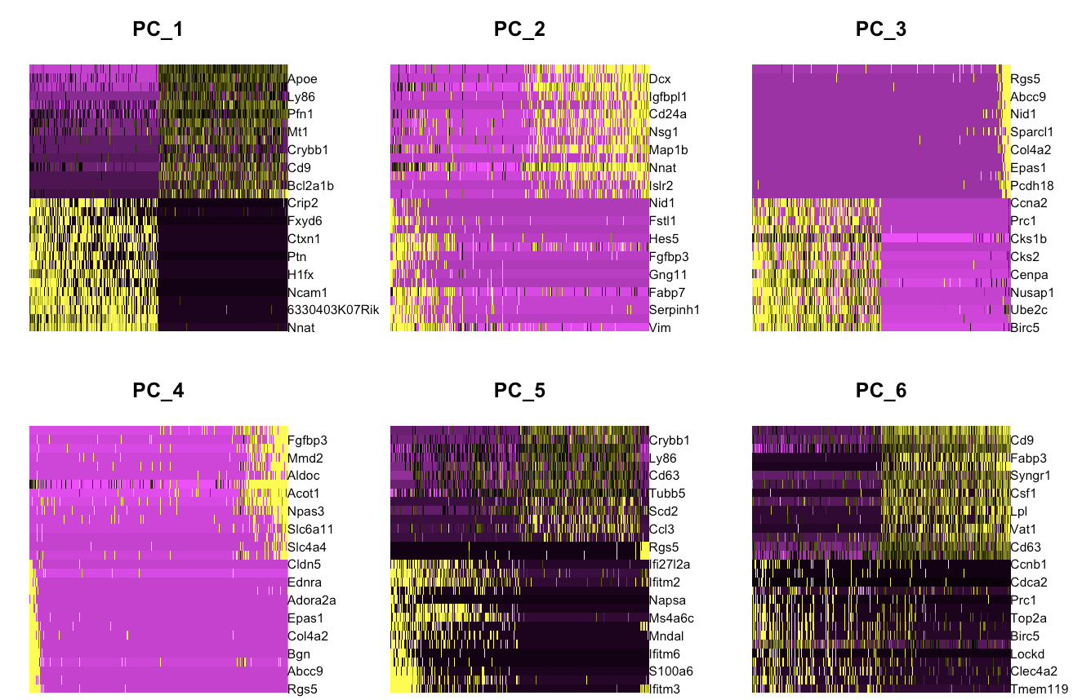
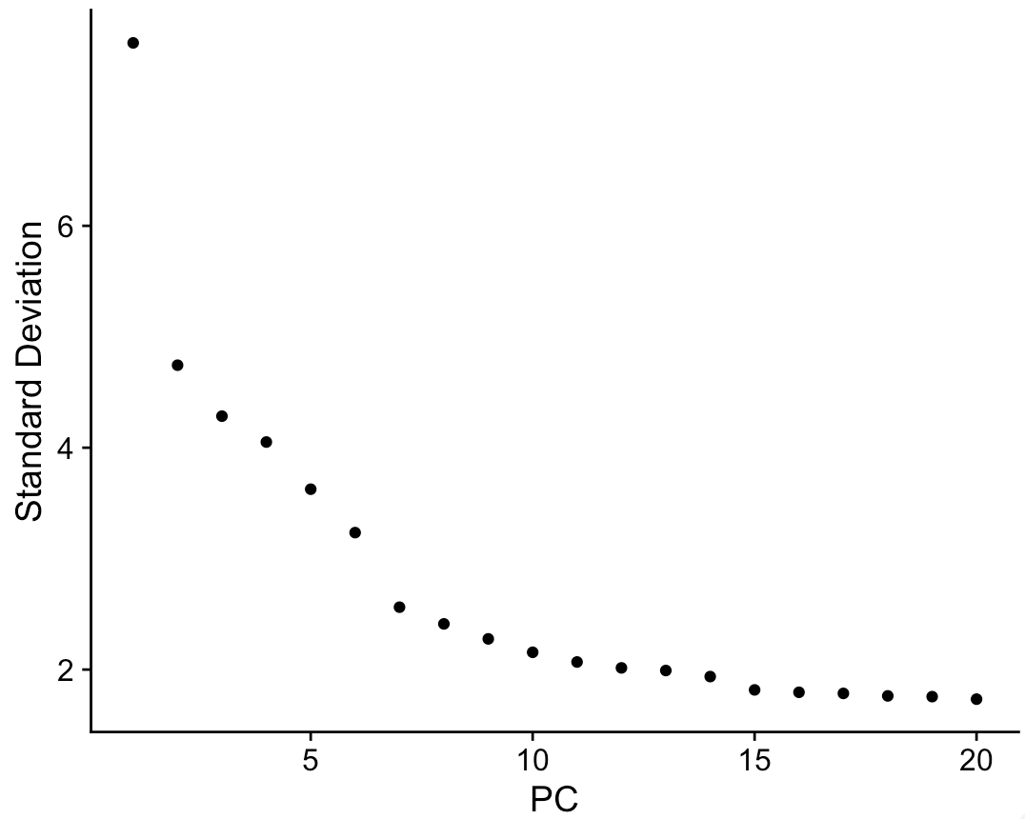
Normalizing data
Results
Principal component analysis (PCA)
combined_seurat: [31053 x 2568]
Notes:
As mentioned before, I also normalized my data, so that it is easier to compare across different cells.
I performed principal component analysis, to simplify the data making it easier to interpret.
When we "normalize" the data, we adjust it so that it's easier to compare across different cells. In my dataset, each cell has a different total amount of RNA. Without normalization, comparing gene expression between cells wouldn’t be fair, because some cells may just have more RNA by chance and normalization helps with this. In short total RNA in each cell is measured and then divided by total RNA count. Then data is scaled and then a logarithmic transformation is used
PCA is essential for later processes like clustering, which benefit from having the data represented in fewer dimensions.
The PCA analysis, on this slide is visualized with a heatmap and an elbow plot:
A heatmap is a color-coded representation of data, often used in single-cell RNA sequencing to display gene expression across cells. Each color reflects expression levels, with cooler colors for low expression and warmer colors for high. Typically, rows represent genes, and columns represent cells, allowing for visual comparison of expression patterns. We can see that the boxes become less clear, suggesting less distinct variability in gene expression.
On the elbow plot’s x axis we see the number of principal components and on the y the percentage of variance explained by each principal component. The "elbow" in the plot is the point where the rate of increase in explained variance slows down significantly. This helps in deciding how many principal components to use in further analyses, such as clustering or visualization. For my further analyses I decided to take the first 8 components since that’s where the elbow is on my elbow plot.
We are just processing data, so it easier to compare, we are also reducing its dimensionality so, we are not getting rid of any genes or cells. Columns and rows remain the same.

Slide 10
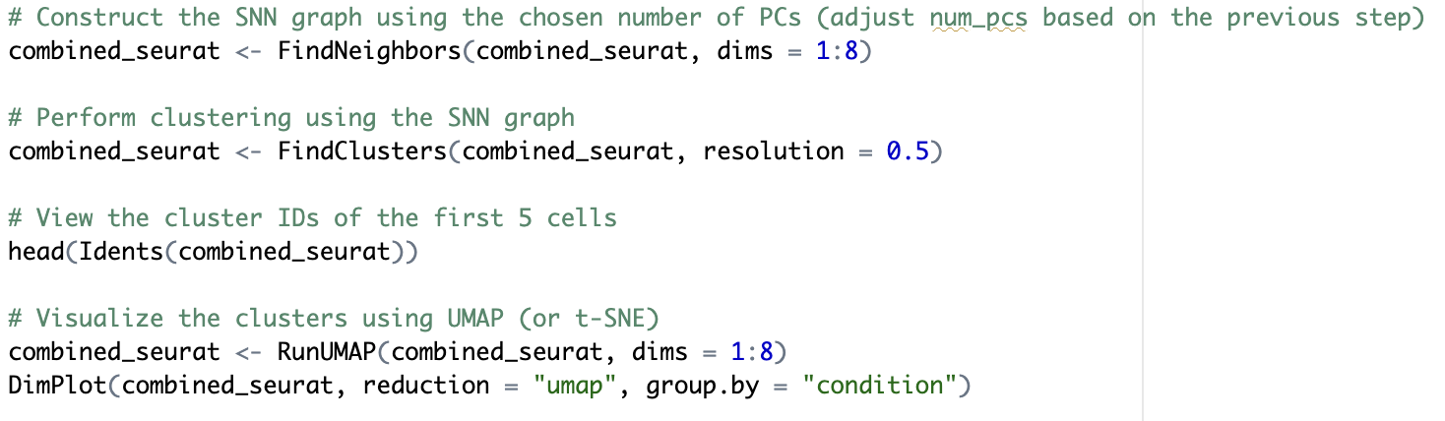
Clustering
Results
UMAP = Uniform Manifold Approximation and Projection
combined_seurat: [31053 x 2568]
Notes:
As mentioned before I then clustered my data based on similarities in gene expression and performed the UMAP
We are just processing data, so it easier to compare, we are also reducing its dimensionality so, we are not getting rid of any genes or cells. Columns and rows remain the same.
Clustering allows researchers to identify distinct cell populations within their dataset, which can represent different cell types, states, or responses to conditions.
Then I The function computes based on the specified principal components. It generates a new set of coordinates for each cell, reducing the dimensionality while maintaining the relationships between cells as effectively as possible.
UMAP is particularly effective for visualizing clusters of cells, helping researchers see how cells are distributed in relation to each other based on their gene expression profiles. Cells that are close together in the UMAP plot represent similar expression profiles.

Slide 11
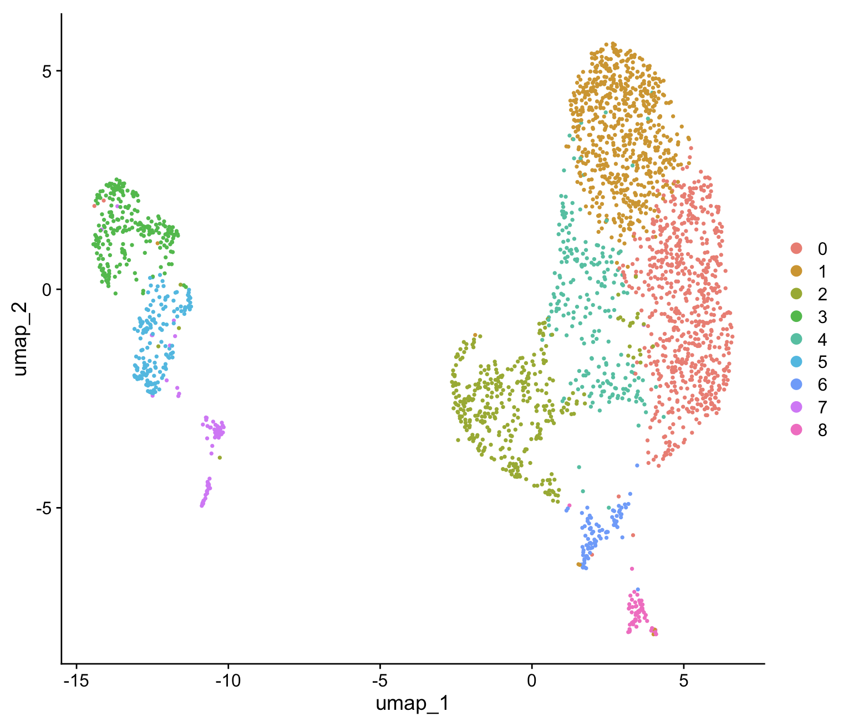
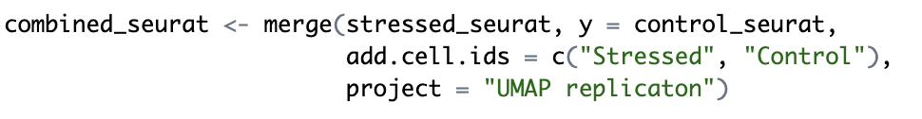
Dr. Rosin’s vs Krysia’s UMAP (merged)
Results
Merged Resolution: 0.5
PCs: 1-8
Rosin et al., 2021
Integrated
Resolution: 0.5
PCs: 1-20
Merged
Resolution: 0.5
PCs: 1-20
Notes:
On the left is Dr. Rosin’s UMAP, and on the right are two versions of my replicated UMAPs
All were created using a resolution of 0.5, which balances granularity in clustering. Higher resolutions may over-cluster, while lower ones can under-cluster
The top plot uses 8 principal components (PCs), while the bottom uses 20 PCs, similar to the paper.
I opted for 8 PCs because, as shown in the elbow plot earlier, this is where the variance starts to plateau, making it a logical choice to reduce noise while retaining meaningful data.
The key difference between these and the paper’s approach is that my UMAPs were created after merging datasets, while the paper used dataset integration. Merging datasets assumes shared gene expression across conditions without aligning batch effects which are variations in data caused by technical differences during experiments, not biological differences. Integration actively corrects batch effects.
Overall, all of these UMAPs are similar in their overall cluster shapes and the separation between groups, which is the primary goal of dimensionality reduction.
So, in my UMAPs, merging still shows clear clusters, so the biological interpretation likely wouldn’t change much compared to integrating.

Slide 12
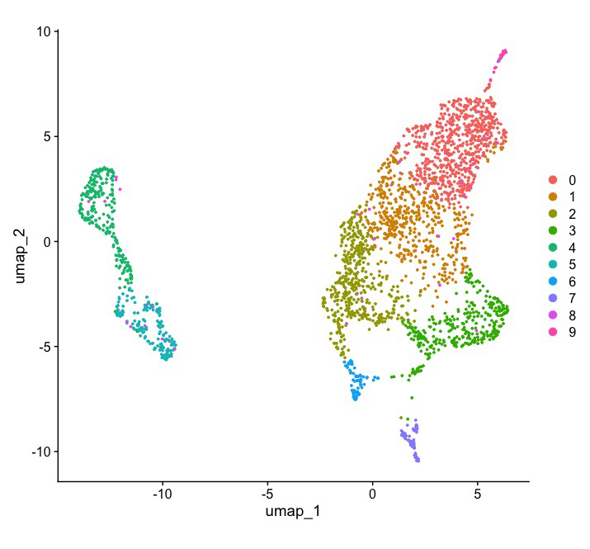
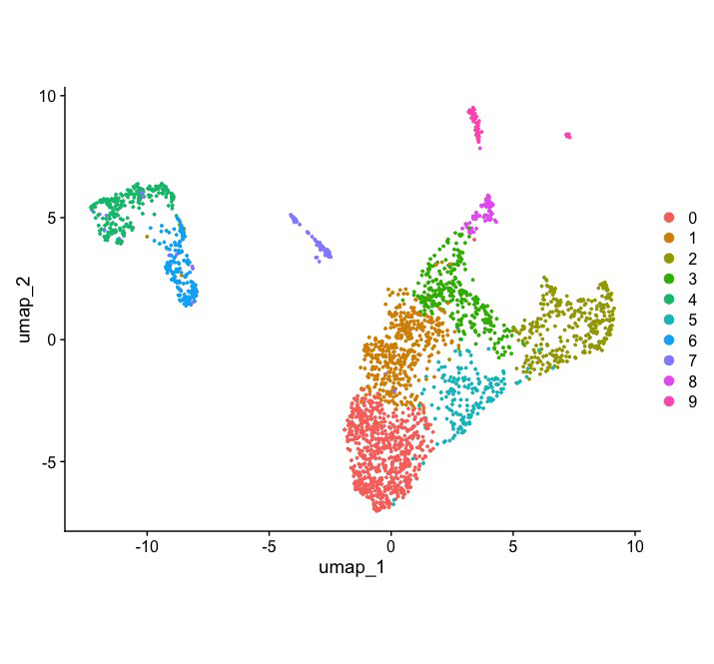
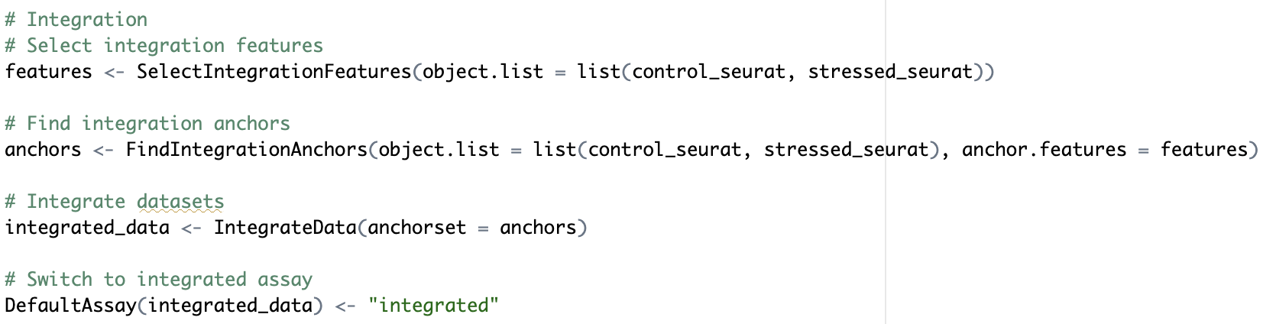
Dr. Rosin’s vs Krysia’s UMAP (integrated)
Results
Merged Resolution: 0.5
PCs: 1-8
Rosin et al., 2021
Integrated
Resolution: 0.5
PCs: 1-20
Merged
Resolution: 0.5
PCs: 1-20
Notes:
When I compared my integrated UMAP plots to Dr. Rosin’s, they looked pretty similar overall.
The clusters are in slightly different positions, but the main patterns and separations are still there.
However, for the rest of my analysis, I used the merged dataset using 8 principal components (PCs), because the clustering matched the published results nicely, and using fewer PCs kept things simple and easy without losing any important biological information.

Slide 13
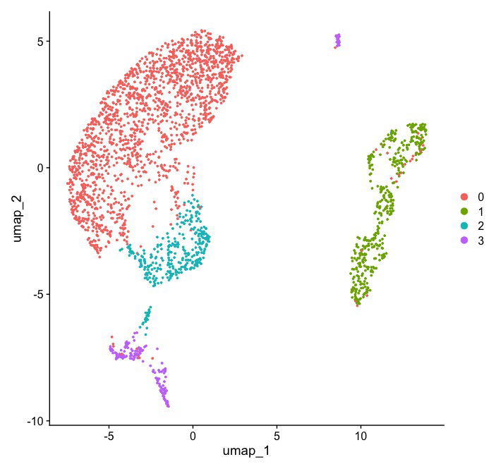
Dr. Rosin’s vs Krysia’s UMAP (lower resolution)
Results
Rosin et al., 2021
Integrated
Resolution: 0.5
PCs: 1-20
Integrated
Resolution: 0.1
PCs: 1-8
Notes:
After some suggestions I created a UMAP with lower resolution and look for the top 10 marker genes that were Dr. Rosin’s cluster.
Lower resolution UMAPs are helpful for grouping cells into broader, more general clusters, which is especially useful when you're trying to identify major cell populations or overall patterns. It simplifies the data, so you can focus on the main biological signals without getting distracted by small, less meaningful subdivisions.

Slide 14
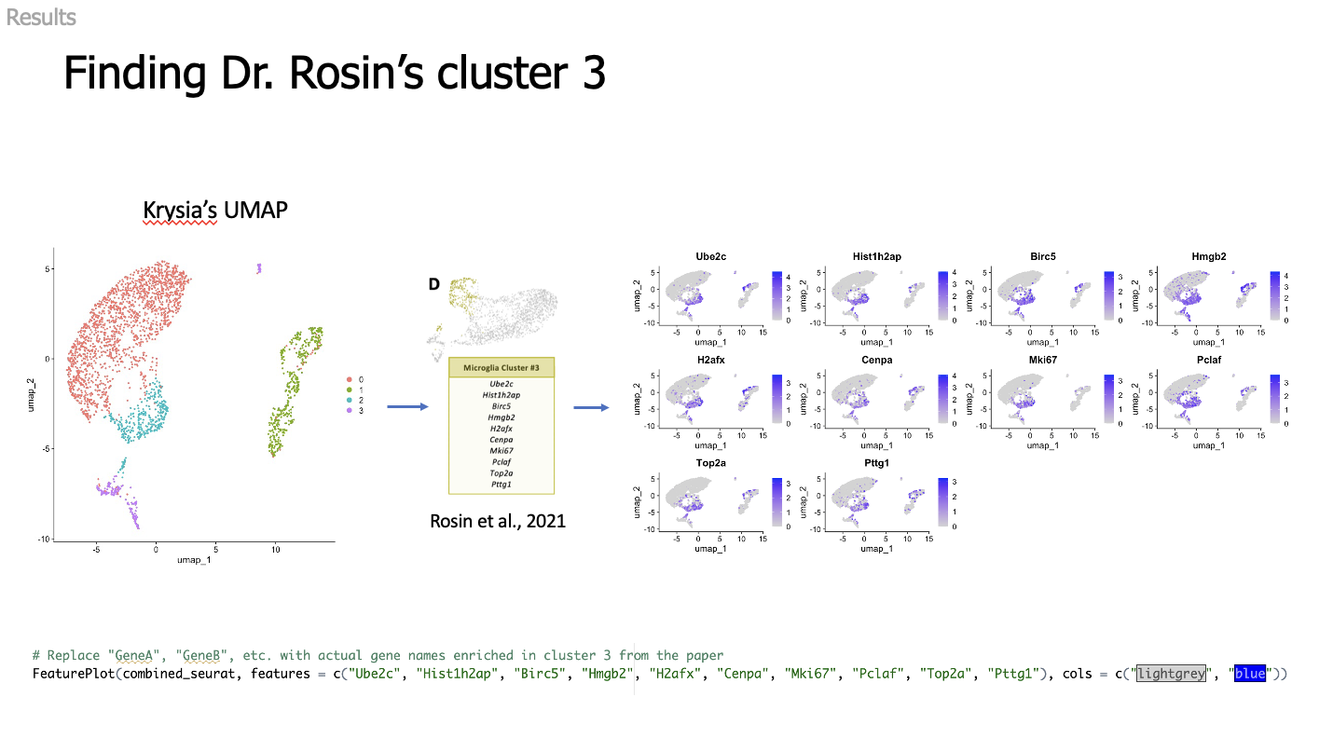
Notes:
I took 10 marker genes that were expressed in Dr. Rosin’s cluster 3 and mapped them to my UMAP. It looks like they are mostly expressed in cluster 2, with some expression in clusters 3 and 1.

Slide 15
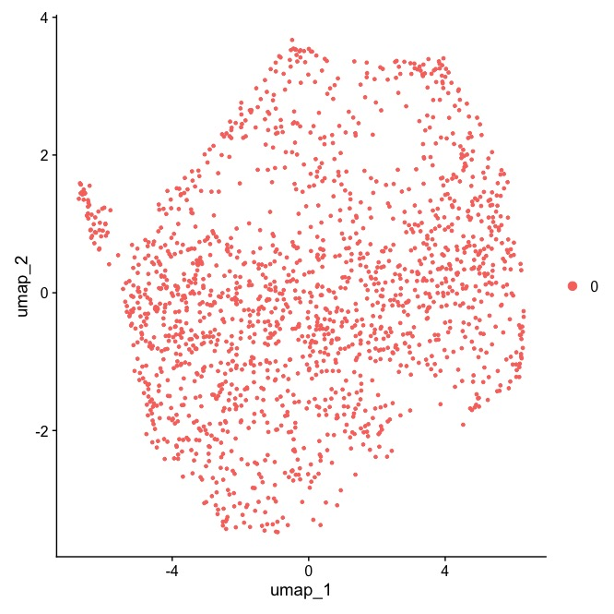
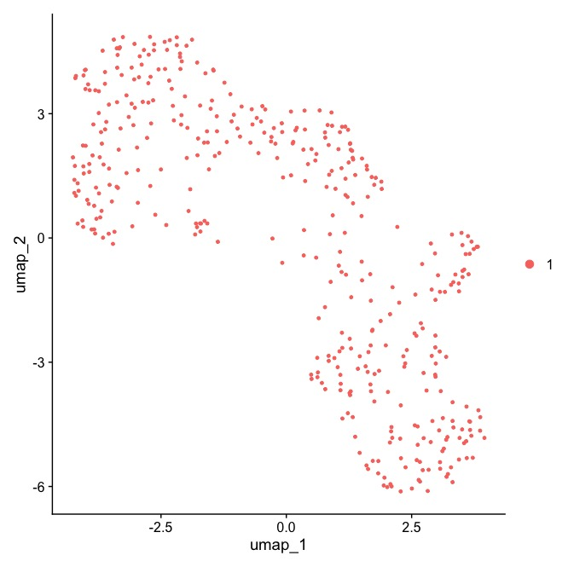
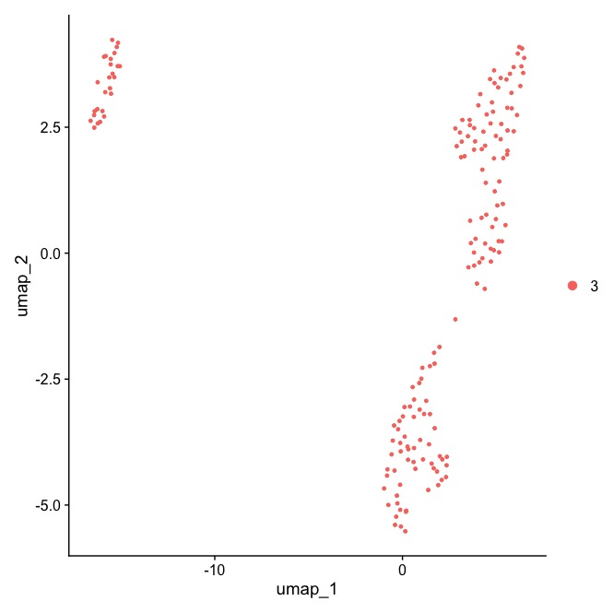
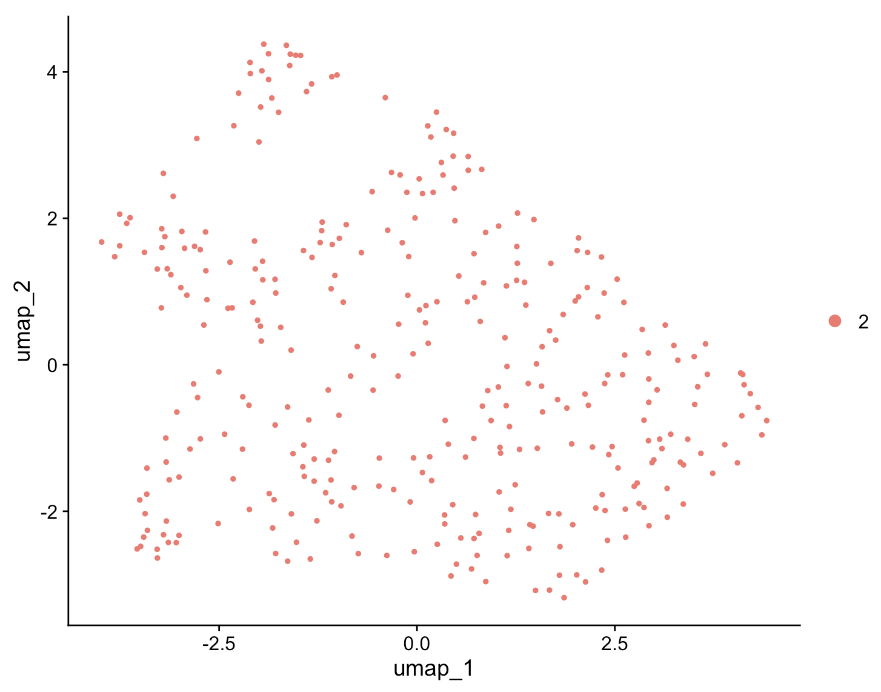
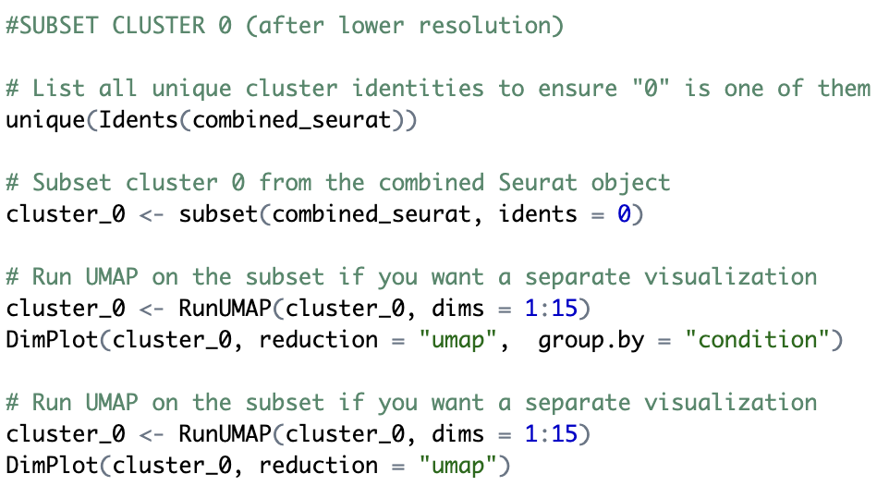
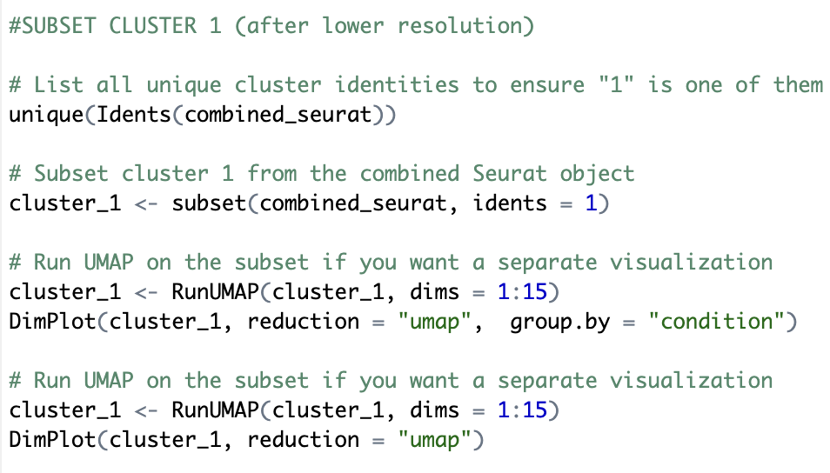
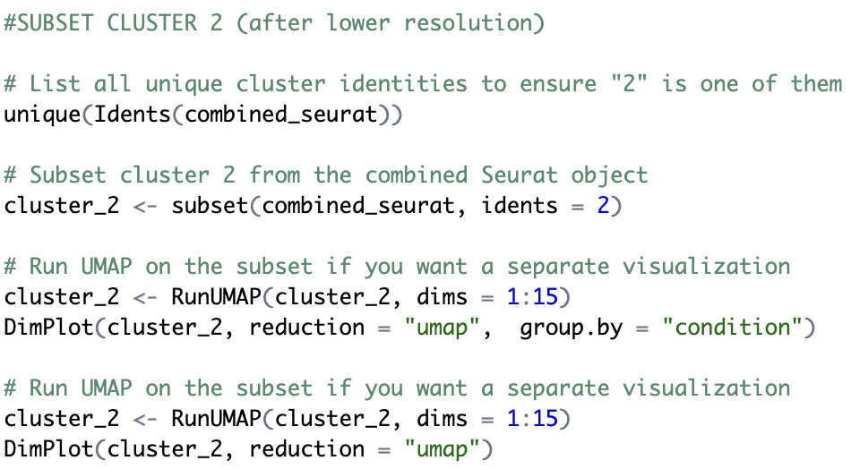
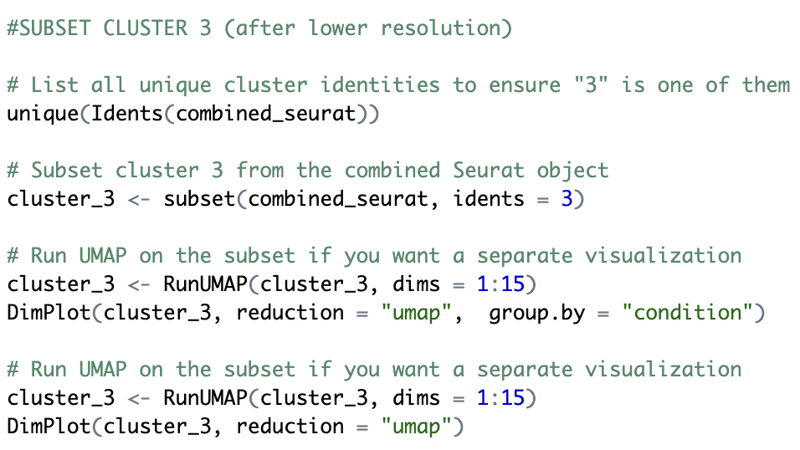
UMAP clusters
Results
Cluster 0
Cluster 1
Cluster 2
Cluster 3
Notes:
I decided to take a closer look at all the clusters, and since cluster 3, not 2 appears the most heterogeneous I chose to subset it for further analysis.

Slide 16
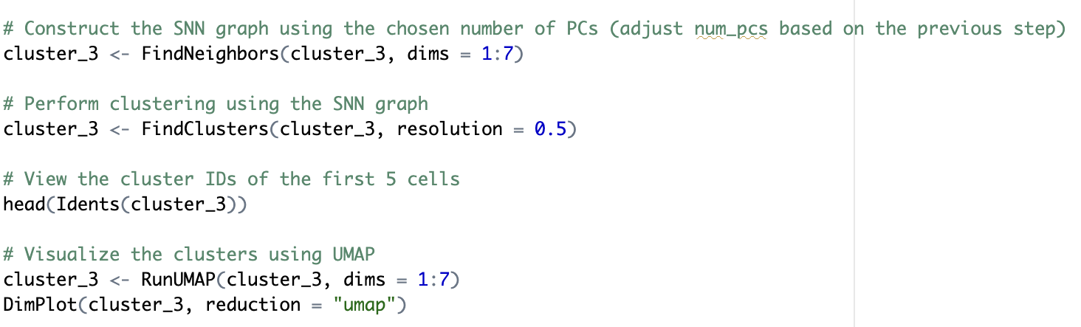
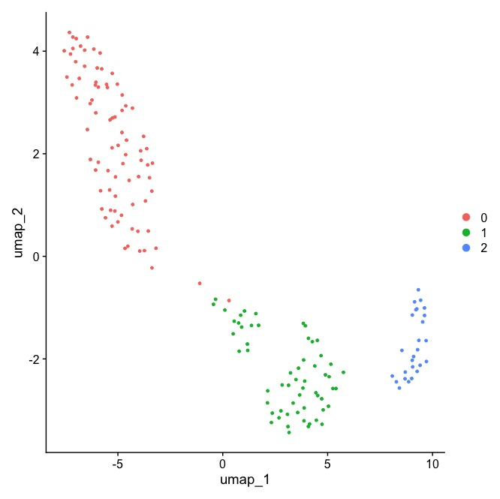
Reclustered cluster 3
Results
Notes:
I reclustered cluster 3 by repeating the same steps I used to replicate Dr. Rosin’s UMAP, and this is how the UMAP looks now.

Slide 17
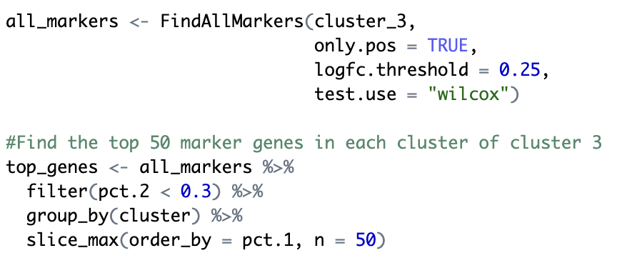
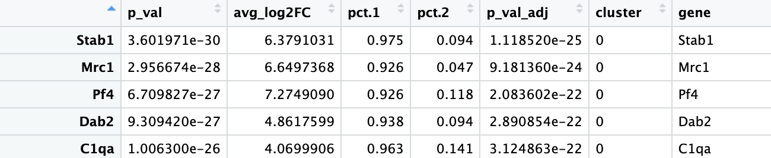
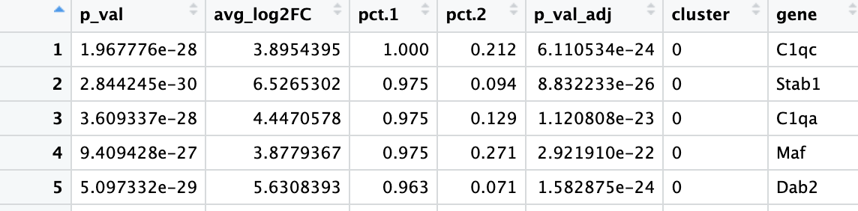
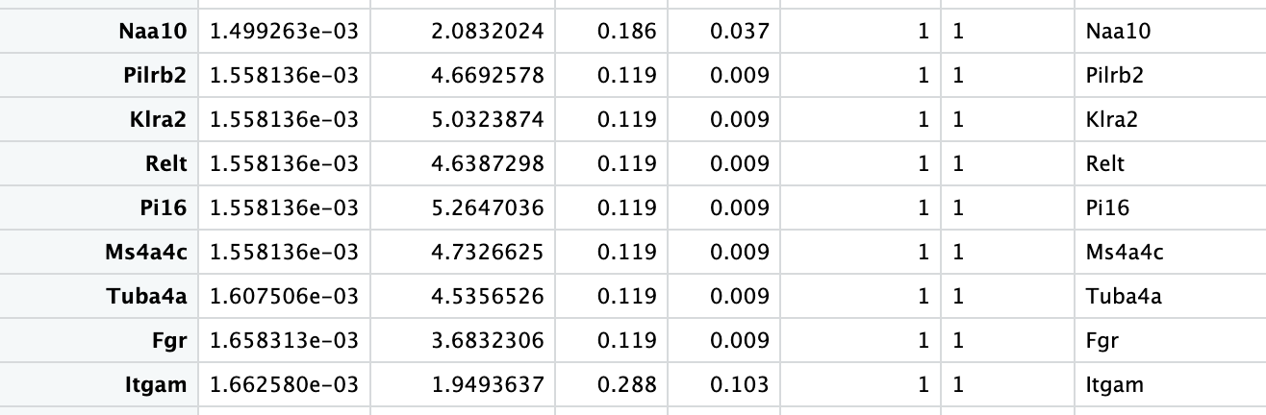
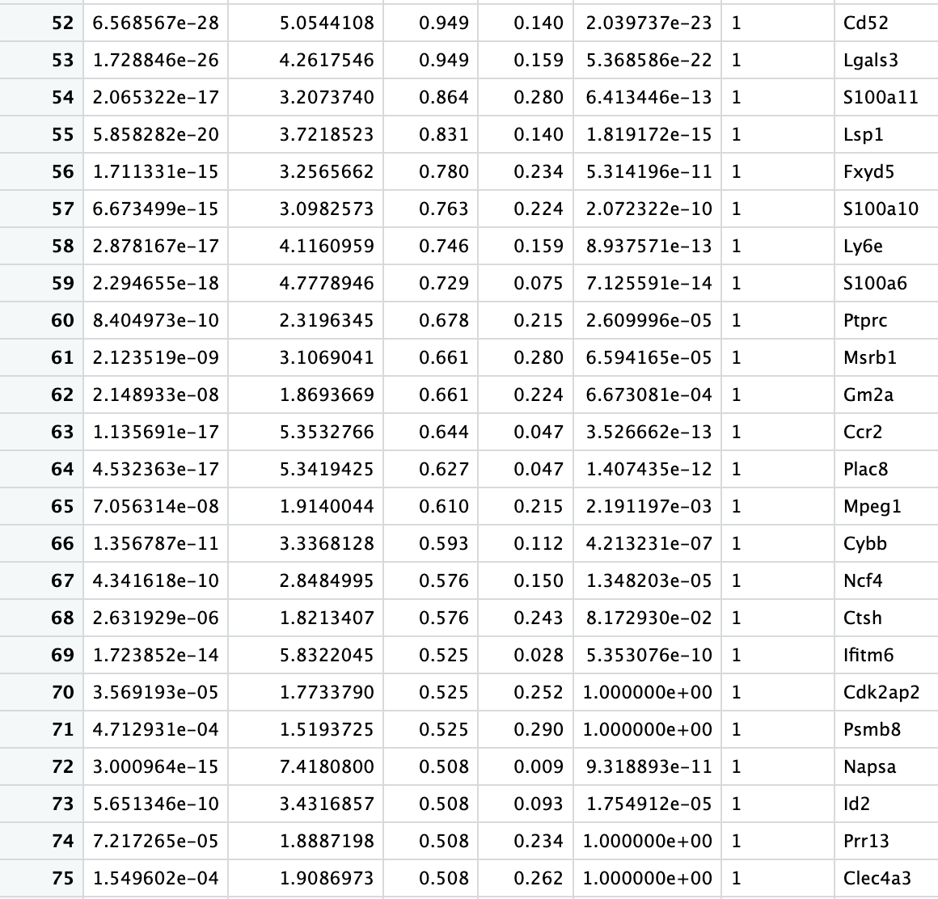
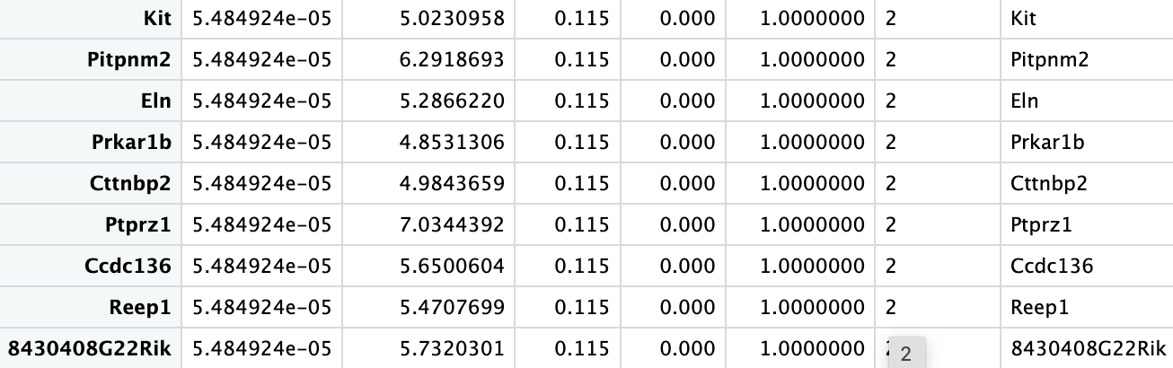
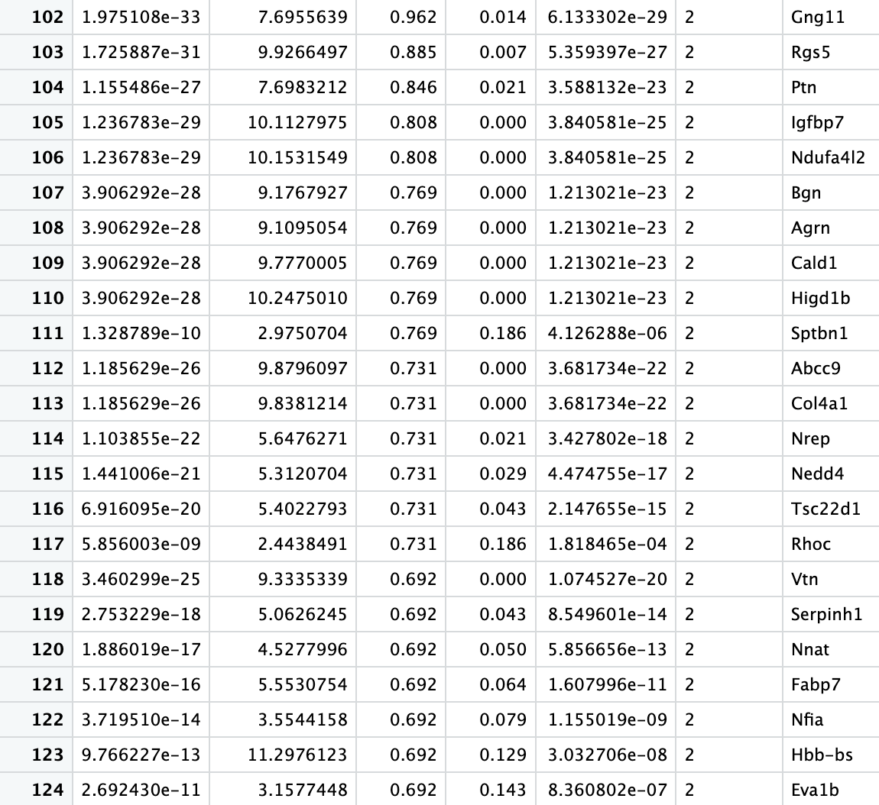
Finding upregulated genes in cluster 3
Results
Notes:
To understand gene expression patterns in cluster 3, I identified marker genes for its subclusters, resulting in a large initial list. Using code, I filtered and sorted for genes highly expressed in one subcluster but less in others, narrowing it down to 50 marker genes per subcluster, ordered by pct.1

Slide 18
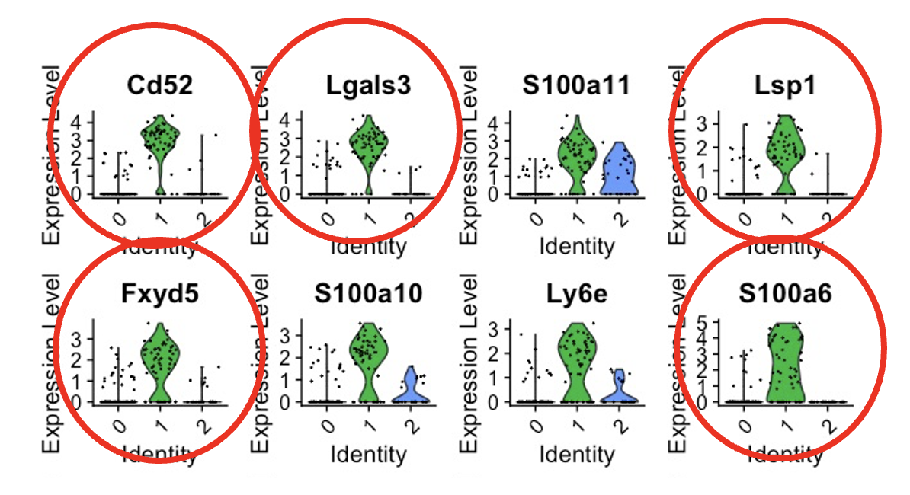
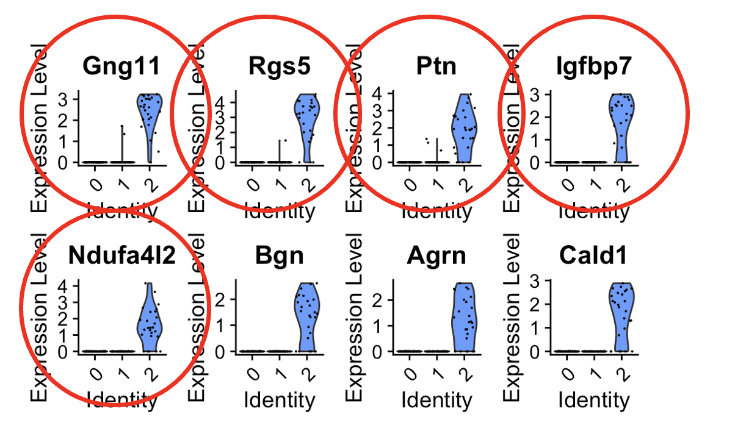
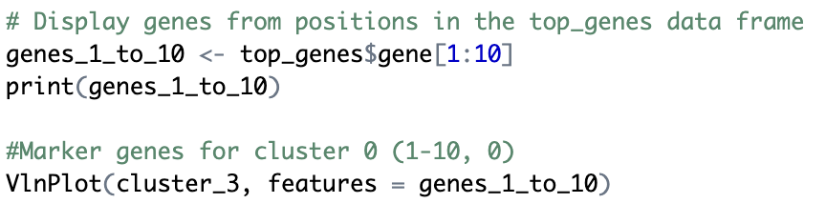


Top 5 marker genes
Results
Cluster 0
Cluster 1
Cluster 2
Immune system activation and clearance of cellular debris
Inflammation, cellular migration, and stress response
Signal transduction, neuroprotection, and energy metabolism
Notes:
After filtering the top 50 marker genes for each cluster and selected the topmost expressed five from each cluster. Then I conducted a literature search to determine their functions.
Cluster 0 genes are heavily involved in immune system activation and clearance of cellular debris. In cluster 1 the focus is on inflammation, cellular migration and stress response and immune signaling. Cluster 3 genes play a part in signal transduction, neuroprotection and energy metabolism
Its genes play roles in activating the complement system, promoting phagocytosis, and clearing cellular debris, which are essential for maintaining tissue health.
In cluster 1 the focus is on inflammation and immune signaling. The genes also regulate cell migration and help cells respond to stress, showing this cluster’s role in dynamic immune responses and repair.
Cluster 3 genes play a part in intracellular communication, neuroprotection, and mitochondrial energy production. Its functions are key for maintaining cell health and supporting the overall metabolic and protective processes within the brain.
Slide Text
Cluster 0: Complement activation (C1qc, C1qa, C1qb), immune regulation (Stab1), and endocytosis (Dab2). Cluster 1: Immune signaling (Cd52, Ccr2), calcium binding (S100a6), cell adhesion (Lsp1, Fxyd5). Cluster 3: Signal transduction (Gng11, Rsg5), neuroprotection (Ptn, Igfbp7), mitochondrial function (Ndufa4I2).
Presenter Notes
Cluster 0:
C1qc, C1qa, and C1qb are components of the complement system involved in immune defense and phagocytosis.
Stab1 plays a role in immune regulation and clearance of dead cells.
Dab2 is linked to endocytosis and intracellular trafficking.
Cluster 1:
Cd52 and Ccr2 are involved in immune signaling and inflammation.
S100a6 binds calcium and is associated with stress responses.
Lsp1 and Fxyd5 regulate cell adhesion and migration.
Cluster 3:
Gng11 and Rsg5 are important in signal transduction pathways.
Ptn (Pleiotrophin) and Igfbp7 are linked to neuroprotection and extracellular matrix interactions.
Ndufa4I2 is a mitochondrial gene involved in oxidative phosphorylation and energy production.

Slide 19






Pathway enrichment analysis (GO)
Results
Cluster 0
Cluster 1
Cluster 2
Receptor Mediated Endocytosis
Extracellular Matrix Organization
Cell Junction Disassembly
Inflammatory response
Endodemal Cell Differentiation
Endocytosis
Endoderm Formation
Regulation of T cell proliferation
Notes:
Another analysis I performed was pathway enrichment analysis, specifically using GO (Gene Ontology) enrichment.
This method identifies biological processes, cellular components, or molecular functions that are significantly overrepresented in the genes from each cluster.
I visualized the results using bar plots, which display the pathways ranked by their level of enrichment
Cluster zero is enriched for processes like cell junction disassembly, synapse pruning, and negative regulation of amyloid-beta formation
Cluster one is enriched for response to hydrogen peroxide, regulation of T cell proliferation, and inflammatory response
Cluster twp is enriched for response to auditory stimulus, neuron projection regeneration, and basement membrane organization

Slide 20





Pathway enrichment analysis (KEGG)
Results
Cluster 0
Cluster 1
Cluster 2
Lysosome
Pathways in cancer
Endocytosis
Phagosome
ECM-receptor interaction
Prion diseases
Focal adhesion
Leukocyte transendothelial migration
Notes:
For this analysis, I performed a KEGG (Kyoto Encyclopedia of Genes and Genomes) pathway enrichment.
KEGG focuses on mapping genes to known metabolic and signaling pathways
Cluster 0 is enriched in pathways related to lysosome, endocytosis, and prion disease
Cluster 1 is enriched for phagosome and leukocyte transendothelial migration
Cluster 2 is enriched in pathways in cancer, ECM (extracellular matrix)-receptor interaction, and focal adhesion

Slide 21



Cluster 3 by condition
Results
Notes:
Since my data comes from two groups of mice—control and cold stress—I wanted to examine the distribution of genes from each condition across the clusters in the UMAP of cluster 3. Interestingly, the clusters show a progressively larger representation of genes from the cold-stress condition.

Slide 22


Outcomes
Discussion
Cold stress might be enhancing immune responses (subcluster 1) while activating neuroprotective and energy-regulating mechanisms (subcluster 2)
Structural reorganization
Neuroprotection
- Immune activation
- Oxidative stress
- Neuronal repair
- Energy production
- Structural maintenance
Specific subsets of microglia exhibit differential activation patterns in response to maternal stress, thereby shaping neurodevelopmental outcomes
Notes:
So, the results suggest that cold stress might be enhancing immune responses (subcluster 1) while activating neuroprotective and energy-regulating mechanisms (subcluster 2).
This means that specific subsets of microglia exhibit differential activation patterns in response to maternal stress, possibly shaping neurodevelopmental outcomes

Slide 23
Next steps
Discussion
Gene Set Enrichment
Pseudotime
Microglial-progenitor interactions (spatial transcriptomics)
Stress paradigms (chronic vs. acute)
Males vs. females
Notes:
Future analyses could include Gene Set Enrichment Analysis to compare predefined gene sets (control vs. stress) and identify functional transcriptomic changes.
Pseudotime analysis could be used to track developmental trajectories under stress.
Investigating microglial-neural progenitor interactions using single-cell RNA-seq or spatial transcriptomics, along with broader analyses across time points and stress paradigms (e.g., chronic vs. acute), would enhance understanding of microglial responses.
Comparing male and female offspring may uncover sex-specific differences in neurodevelopment and stress responses.

Slide 24
Alternatively…
Discussion
DAVID analysis on differentially expressed genes between conditions for each cluster
Obtaining Dr.Rosin’s code + subclustering cluster 3 using integrated data
Notes:
If I were to repeat this project, I would focus on running DAVID analysis on differentially expressed genes (DEGs) between conditions for each cluster, rather than analyzing marker genes and conditions separately. Additionally, obtaining the original code from the Rosin lab programmer would allow me to directly subcluster cluster 3 from the paper’s UMAP instead of relying on identifying the most heterogeneous cluster in my recreated UMAP.

Slide 25


OSF page
Discussion
Link: https://osf.io/475ug/?view_only=ca9801b037a340898f36e7279c05e689
Notes:
All project files, including code, datasets, presentations, and proposals, are uploaded to GitHub or directly to the OSF page and are accessible under the "Files" section. The project description is available under the "Wiki" tab.

Slide 26
References
Harry, G. J., & Kraft, A. D. (2012). Microglia in the developing brain: a potential target with lifetime effects. Neurotoxicology, 33(2), 191–206. https://doi.org/10.1016/j.neuro.2012.01.012
Heumos, L., Schaar, A. C., Lance, C., Litinetskaya, A., Drost, F., Zappia, L., Lücken, M. D., Strobl, D. C., Henao, J., Curion, F., Single-cell Best Practices Consortium, Schiller, H. B., & Theis, F. J. (2023). Best practices for single-cell analysis across modalities. Nature reviews. Genetics, 24(8), 550–572. https://doi.org/10.1038/s41576-023-00586-w
Manzari, N., Matvienko-Sikar, K., Baldoni, F., O'Keeffe, G. W., & Khashan, A. S. (2019). Prenatal maternal stress and risk of neurodevelopmental disorders in the offspring: a systematic review and meta-analysis. Social psychiatry and psychiatric epidemiology, 54(11), 1299–1309. https://doi.org/10.1007/s00127-019-01745-3
Rosin, J. M., & Kurrasch, D. M. (2018). In utero electroporation induces cell death and alters embryonic microglia morphology and expression signatures in the developing hypothalamus. Journal of neuroinflammation, 15(1), 181. https://doi.org/10.1186/s12974-018-1213-6
Rosin, J. M., Sinha, S., Biernaskie, J., & Kurrasch, D. M. (2021). A subpopulation of embryonic microglia respond to maternal stress and influence nearby neural progenitors. Developmental cell, 56(9), 1326–1345.e6. https://doi.org/10.1016/j.devcel.2021.03.018
U.S. National Library of Medicine. (n.d.-a). Home - gene - NCBI. National Center for Biotechnology Information. https://www.ncbi.nlm.nih.gov/gene/

Slide 27
Thank you

